Slide 1

Lunch and Learn Data Science with R
Quick Into to Adobe Analytics
Using the Adobe Analytics API within R for web analytics
Patrick Little
Product Owner, Open.Canada.ca
Treasury Board of Canada Secretariat
September 2021

Slide 2
Adobe Analytics – Background / GC Context
Adobe Analytics is the Enterprise Web Analytics for the GC. This tool is an enterprise service administered by Service Canada. All Canada.ca partner departments should have access to this tool, and the list of who to talk to in your department is here: https://www.gcpedia.gc.ca/wiki/Institutional_Representatives_for_Analytics
This environment reports web analytics data from Canada.ca + about 120 non-canada.ca websites/web apps.
One of the great features of the GC implementation of Adobe Analytics is a flat permissions structure, allowing all users with an account to view web analytics data from everything reporting into this system. This is useful for bench marking applications against each other across departments.
To access Adobe Analytics you need to complete a training session provided by Service Canada, and request an account through your departmental representative.
Training & Account Request: https://www.gcpedia.gc.ca/wiki/Principal_Publisher_-_Training#Adobe_Analytics_User_Training
When using the API you’ll want to have the training guide handy to look up the codes for all of the dimensions, segments, and metrics.

Slide 3
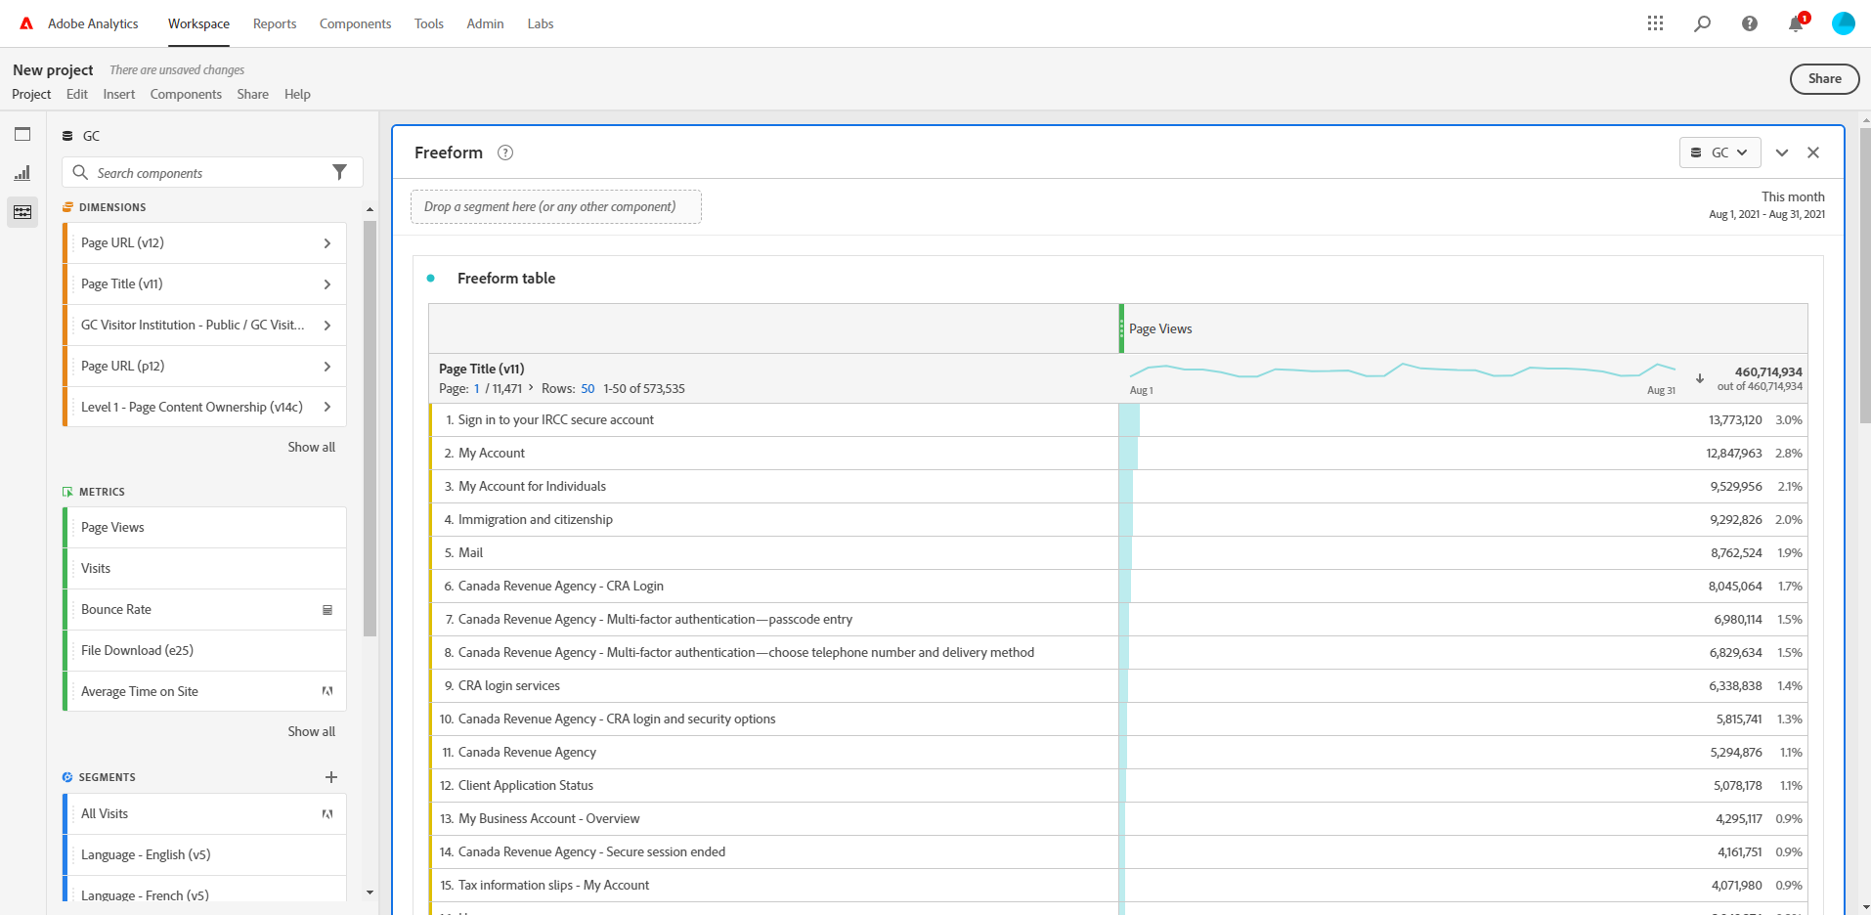
Adobe Analytics – Quick Intro
Start by going to workspace -> new project -> blank project
Add report level filters here
Set the time period of your report
Add what you want to measure here – you can add several
Add what you want your result broken down by here

Slide 4
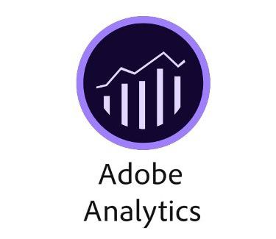
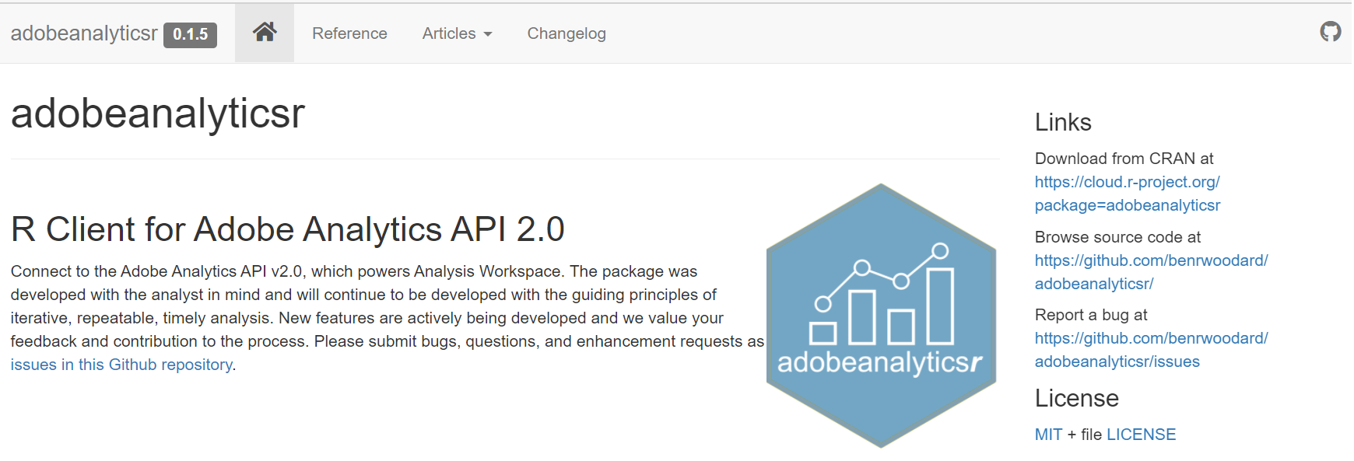
Using Adobe Analytics API within R
We can use the adobeanalyticsr package to do the same type of reports we can do in the user interface, but with the advantage of being able to combine the data from Adobe Analytics with the powerful data manipulation, plotting, and analysis features of R.
Once you have an Adobe Analytics account – Service Canada can give you an credentials to access the API.

Slide 5
Demo
lunch_and_learn_opengov/AdobeAnalytics at main · open-canada/lunch_and_learn_opengov · GitHub
Note on troubleshooting – if you are getting HTTP400 error with aw_token() or get_me() delete the aa.oauth file from your working directory
Note on authentication model – One issue with the way this package handles authentication is that is relies on the browser – so can’t be automated with GH Actions or similar.

